Slide 1
Data Pipeline Architecture : From Extraction to Processed Storage
*

Slide 2
Data Pipeline Diagram
‘
Data Extraction
Student Data Table (PostgreSql)
Data Transformation
Fact Table (Student Performance Data)
- Dimension Tables (Grades, Attendance, Socioeconomic Status, Study Hours, Sleep Hours)
Data Storage (PostgreSQL)
Missing Data Handling
Categorical Encoding
Anomaly Filtering
Feature Engineering
Monitoring
Notes:
The goal of this pipeline is to ensure data integrity, usability, and efficient querying of student performance data. A well-structured pipeline automates the ingestion, transformation, and optimized storage, making sure the data is ready for analytics, decision-making, and reporting.
Data Extraction
Raw student data are being pulled out from a PostgreSQL database, with details like grades, attendance, socio-economic status, study hours, and sleep hours. The data is being pulled out prior to cleaning and transformation.
Data Transformation
The data is cleaned by handling missing values, encoding categorical variables, and dropping anomalies to obtain consistency. Feature engineering is then applied to enhance the dataset by incorporating new relevant features for analysis.
Data Storage
The transformed data is retained in a normalized PostgreSQL schema, and there is a single fact table for student performance with separate dimension tables for category data. The data set is maintained and updated with new entries or changes by batch processing periodically.
Technologies Used
SQL is used for querying and data transformation within PostgreSQL to maintain effective data handling. Python with Pandas is used for data wrangling with data cleaning, transformation, and feature engineering.

Slide 3
Data flow
Rationale for Processing Strategy
Scheduled Batch Jobs: Ideal for periodic refreshes, preserving structured ingestion at set intervals.
Rationale: The student data is static with periodic refreshes, thus batch processing is best.
Future Optimizations: Migration to incremental processing will improve future efficiency.
Notes:
Justification for Processing Approach
Scheduled Batch Jobs: Most appropriate for scheduled intake of the student data on a periodic basis, with a assurance that data updates will occur at specified times.
Rationale: Student data consists mostly of periodic updates (new student records, grade changes) which are not real-time and therefore are effectively processed in batch mode.
Future Enhancements: In the long term, a transition to incremental data processing will allow processing only new data added or changed, which will be more efficient, reduce load, and speed up data updates.

Slide 4
Data Format
Storage Format Selection
Optimized Database Tables: Enabling fast querying and relational integrity.
PostgreSQL Normalization: Efficient structure for analytics with minimal data redundancy.
Why This Selection? Tables support indexing, joins, and security, in contrast to flat files..
Notes:
Choice of Storage Format
Optimized Database Tables: The use of optimized PostgreSQL database tables provides fast query performance and relational integrity through foreign key constraints and normalization.
PostgreSQL Normalization: Normalized table schemas minimize redundancy, making it easier to maintain data integrity and consistency across various categories (grades, attendance, etc.).
Why This Choice? Compared to flat file formats like CSV or Parquet, relational tables allow for indexing, efficient joins, and improved data security. These features make PostgreSQL a more scalable and robust choice for storing and analyzing structured student data.

Slide 5
Data Quality
Data quality is most important in any student performance analytics pipeline, as it directly affects the accuracy, equity, and dependability of predictions. Low-quality data, such as missing values, duplicates, and outliers, can lead to biased outputs, which would reduce the efficacy of any predictive models. For instance, missing student records (e.g., missing grades or attendance) can be skewed unless adequately addressed, while duplicate student records can distort trends, and outliers in study or sleep duration can disproportionately affect performance predictions. The data must be thoroughly cleaned, consistent, and fully representative prior to training any model so as not to offer misleading conclusions or decisions.
It would be possible to maintain quality data by having strict validation and monitoring throughout the pipeline. Pre-processing checking for missing values, duplicate records, and outliers with subsequent imputation, de-duplication, or removal of anomalies as a measure is covered. Drift checks in data distributions over time (e.g., changes in students attending school or socio-economic status) will need to be monitored to ensure the model remains current. Early detection and ongoing data validation support the creation of robust and accurate student performance models, which lead to better decision-making and risk reduction in forms such as ineffective educational interventions or uninformed policy decisions.

Slide 6
Data Quality Issue
Common Data Challenges Missing Data: Gaps identified in critical fields like grades, attendance, and socio-economic status. Duplicate Records: Redundant student records, causing inconsistencies in performance analysis. Extreme Values: Outliers in study hours and sleep hours affecting the analysis of student behavior. Categorical Discrepancies: Inconsistencies in fields like grade categories and attendance categories.
Notes:
1. Missing Data:
Gaps in critical fields like grades, attendance, and socio-economic status.
Incomplete data could lead to biased analysis and inaccurate performance predictions.
2. Duplicate Records:
Presence of redundant student records creates inconsistencies.
Duplicates skew analysis and can lead to erroneous conclusions.
3. Extreme Values:
Outliers in study hours and sleep hours affect the analysis of student behavior.
Extreme values can distort models and predictions of academic performance.
4. Categorical Discrepancies:
Inconsistent values in grade categories and attendance classifications.
Discrepancies in categories can cause misinterpretation of data.

Slide 7
Validation & Quality Measures
Completing Missing Fields: Imputation of missing values by mean or domain-specific approach, such as replacing missing grades by the average mark.
Removing Duplicates: Finding duplicate student records based on student IDs and performance data.
Treatment of Outliers: Using statistical models to detect and adjust for outliers, such as very high study hours.
Categorical Data Unification: Standardizing category labels in attendance, socio-economic status, and grades to ensure consistency.
Notes:
Filling Missing Fields:
Impute missing values with the mean for numerical fields or domain-specific heuristics (e.g., replacing missing grades with average score).
Ensures that the dataset remains complete for analysis.
2. Removing Duplicates:
Identify and remove duplicate student records based on unique student IDs.
Prevents redundancy and maintains data integrity in performance analysis.
3. Outlier Treatment:
Detect and adjust extreme values (e.g., unusually high study or sleep hours) using statistical methods like z-scores or IQR.
Ensures the model is not biased by outliers.
4. Categorical Data Unification:
Standardize categories in fields like grades, attendance, and socio-economic status.
Enhances consistency and reduces ambiguity in the analysis.

Slide 8
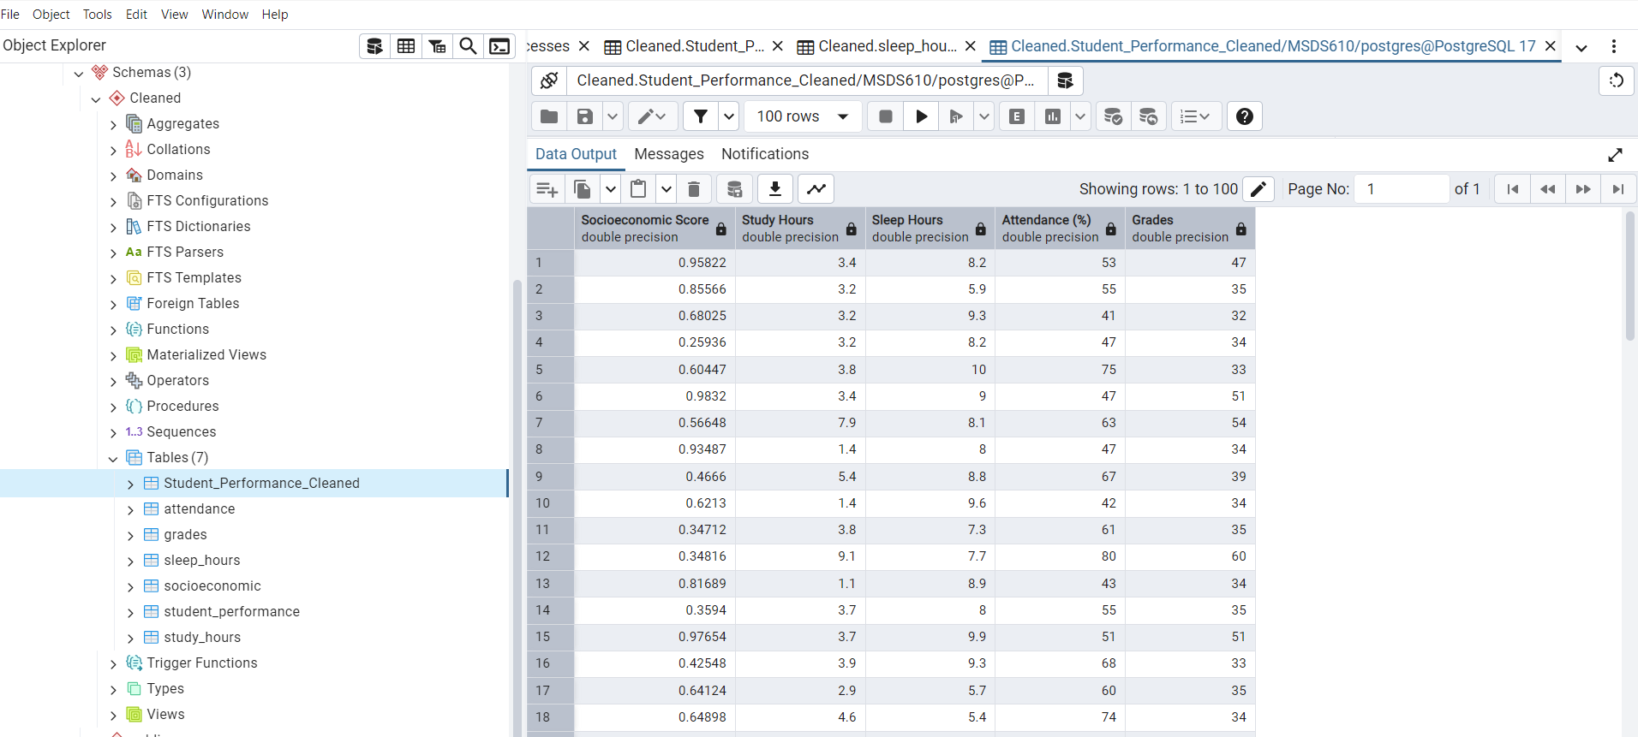
Screenshot of Database

